Slide 1
Hospital Management System
SQL Based Project Presentation

Slide 2
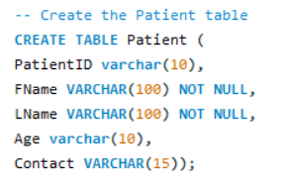
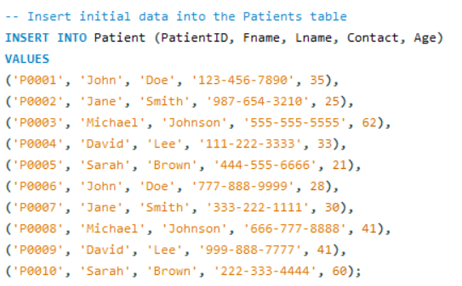
1. Patient Table:
PatientID | Fname | Lname | Contact | Age
P0001 | John | Doe | 123-456-7890 | 35
P0002 | Jane | Smith | 987-654-3210 | 25
P0003 | Michael | Johnson | 555-555-5555 | 62
P0004 | David | Lee | 111-222-3333 | 33
P0005 | Sarah | Brown | 444-555-6666 | 21
P0006 | John | Doe | 777-888-9999 | 28
P0007 | Jane | Smith | 333-222-1111 | 30
P0008 | Michael | Johnson | 666-777-8888 | 41
P0009 | David | Lee | 999-888-7777 | 41
P0010 | Sarah | Brown | 222-333-4444 | 60

Slide 3
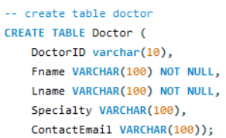
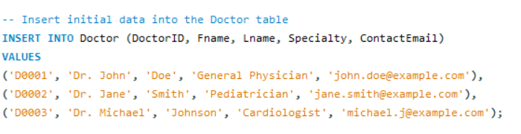
2. Doctor Table:
DoctorID | Fname | Lname | Speciality | ContactEmail
D0001 | Dr. John | Doe | General Physician | john.doe@example.com
D0002 | Dr. Jane | Smith | Pediatrician | jane.smith@example.com
D0003 | Dr. Michael | Johnson | Cardiologist | michael.j@example.com

Slide 4
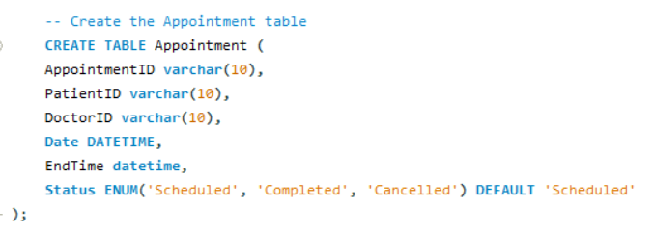
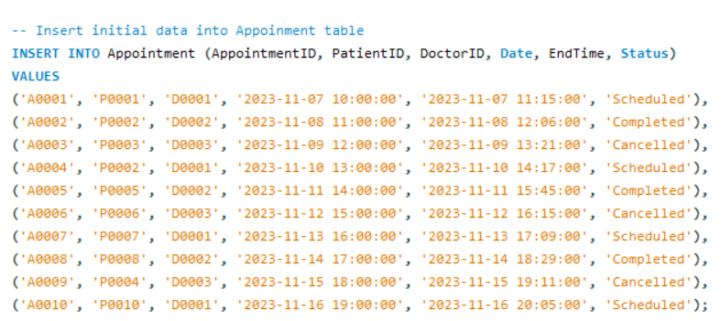
3. Appointment:
AppointmentID | PatientID | DoctorID | Date | EndTime | Status
A0001 | P0001 | D0001 | 07-11-2023 10:00 | 07-11-2023 11:15 | Scheduled
A0002 | P0002 | D0002 | 08-11-2023 11:00 | 08-11-2023 12:06 | Completed
A0003 | P0003 | D0003 | 09-11-2023 12:00 | 09-11-2023 01:21 | Cancelled
A0004 | P0002 | D0001 | 10-11-2023 13:00 | 10-11-2023 14:17 | Scheduled
A0005 | P0005 | D0002 | 11-11-2023 14:00 | 11-11-2023 15:45 | Completed
A0006 | P0006 | D0003 | 12-11-2023 15:00 | 12-11-2023 16:15 | Cancelled
A0007 | P0007 | D0001 | 13-11-2023 16:00 | 13-11-2023 17:09 | Scheduled
A0008 | P0008 | D0002 | 14-11-2023 17:00 | 14-11-2023 18:29 | Completed
A0009 | P0004 | D0003 | 15-11-2023 18:00 | 15-11-2023 19:11 | Cancelled
A0010 | P0010 | D0001 | 16-11-2023 19:00 | 16-11-2023 20:05 | Scheduled

Slide 5
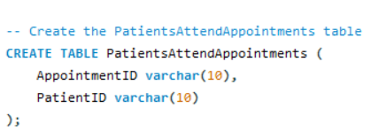
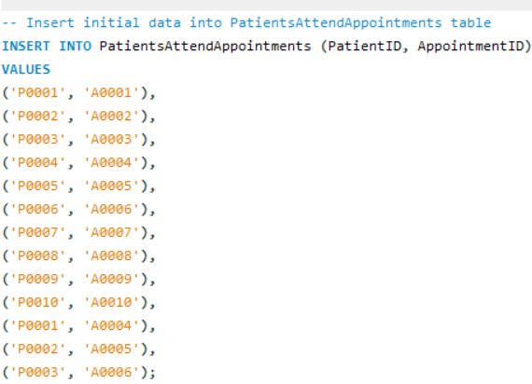
4. PatientsAttendAppointments Table:
PatientID | AppointmentID
P0001 | A0001
P0002 | A0002
P0003 | A0003
P0004 | A0004
P0005 | A0005
P0006 | A0006
P0007 | A0007
P0008 | A0008
P0009 | A0009
P0010 | A0010
P0001 | A0004
P0002 | A0005
P0003 | A0006

Slide 6
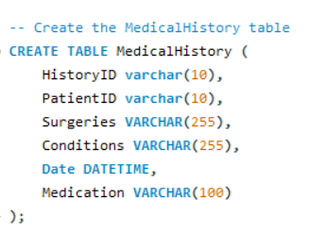
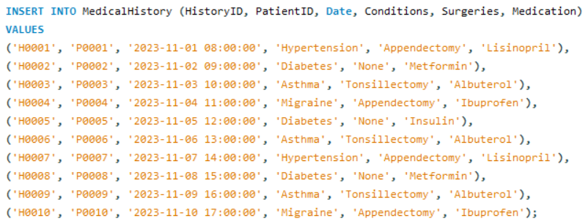
5. MedicalHistory Table:
HistoryID | PatientID | Date | Condition | Surgeries | Medication
H0001 | P0001 | 01-11-2023 08:00 | Hypertension | Appendectomy | Lisinopril
H0002 | P0002 | 02-11-2023 09:00 | Diabetes | None | Metformin
H0003 | P0003 | 03-11-2023 10:00 | Asthma | Tonsillectomy | Albuterol
H0004 | P0004 | 04-11-2023 11:00 | Migraine | Appendectomy | Ibuprofen
H0005 | P0005 | 05-11-2023 12:00 | Diabetes | None | Insulin
H0006 | P0006 | 06-11-2023 13:00 | Asthma | Tonsillectomy | Albuterol
H0007 | P0007 | 07-11-2023 14:00 | Hypertension | Appendectomy | Lisinopril
H0008 | P0008 | 08-11-2023 15:00 | Diabetes | None | Metformin
H0009 | P0009 | 09-11-2023 16:00 | Asthma | Tonsillectomy | Albuterol
H0010 | P0010 | 10-11-2023 17:00 | Migraine | Appendectomy | Ibuprofen

Slide 7
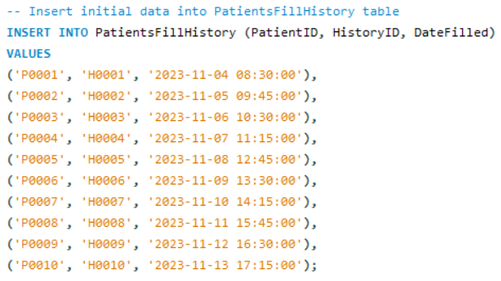
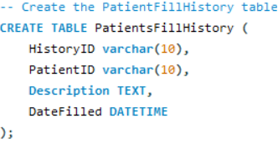
6. PatientsFillHistory Table:
PatientID | HistoryID | DateFilled
P0001 | H0001 | 04-11-2023 08:30
P0002 | H0002 | 05-11-2023 09:45
P0003 | H0003 | 06-11-2023 10:30
P0004 | H0004 | 07-11-2023 11:15
P0005 | H0005 | 08-11-2023 12:45
P0006 | H0006 | 09-11-2023 13:30
P0007 | H0007 | 10-11-2023 14:15
P0008 | H0008 | 11-11-2023 15:45
P0009 | H0009 | 12-11-2023 16:30
P0010 | H0010 | 13-11-2023 17:15

Slide 8
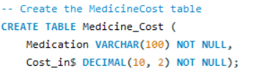
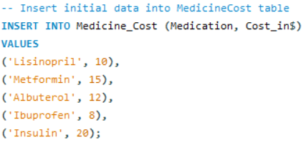
7. Medication_Cost
Medication | Cost_in$
Lisinopril | 10
Metformin | 15
Albuterol | 12
Ibuprofen | 8
Insulin | 20

Slide 9
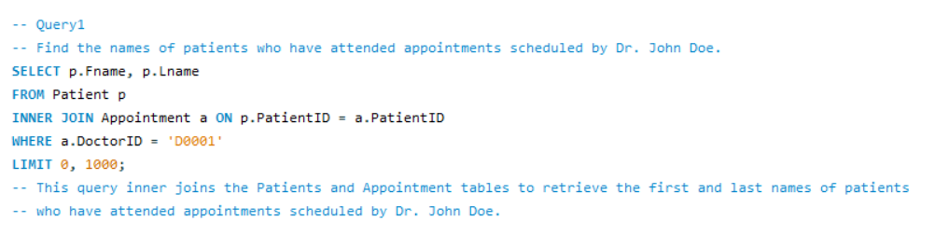
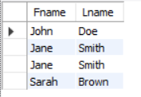

Slide 10
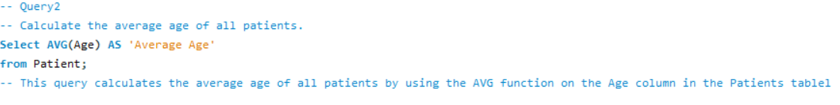


Slide 11
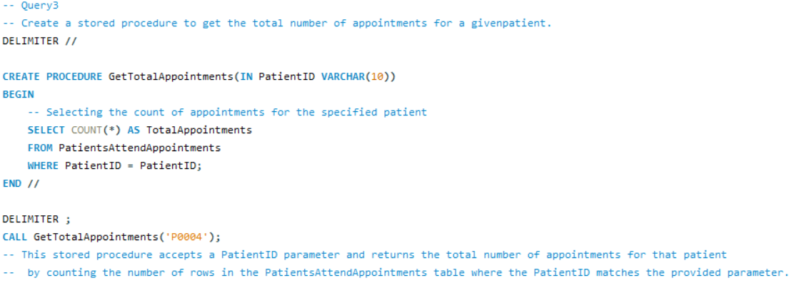


Slide 12
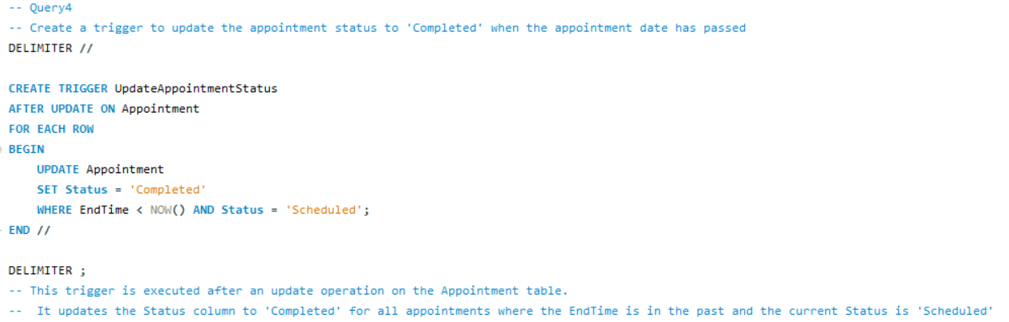

Slide 13
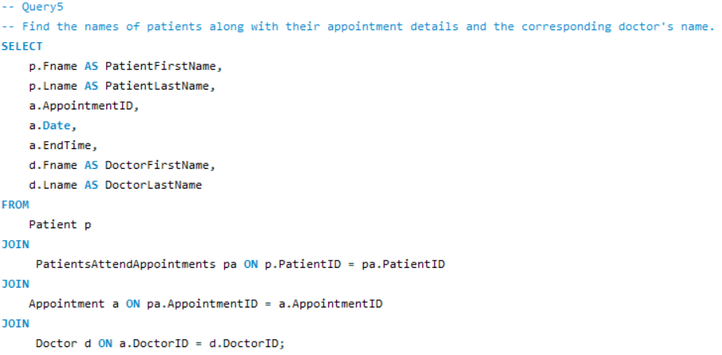
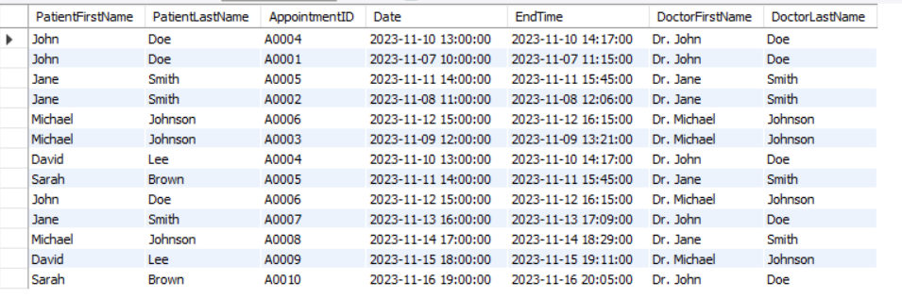

Slide 14
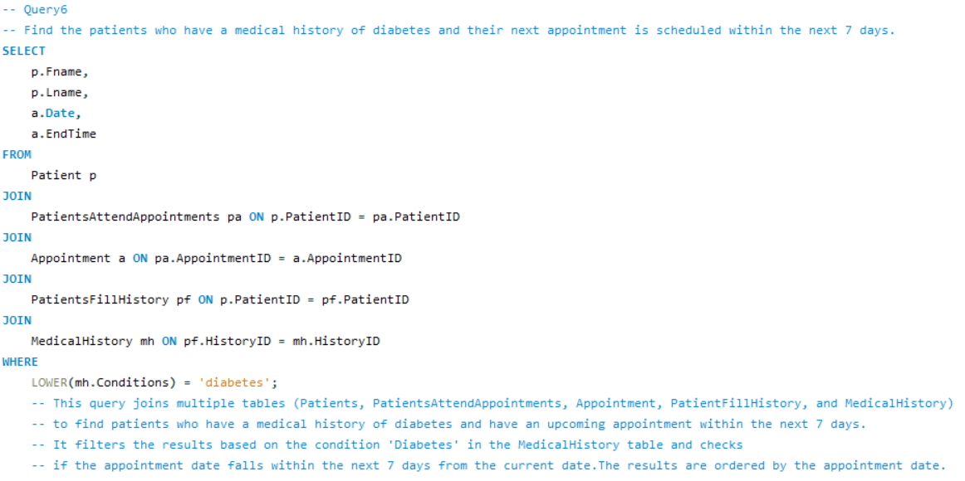
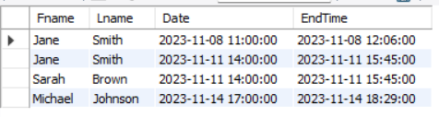

Slide 15
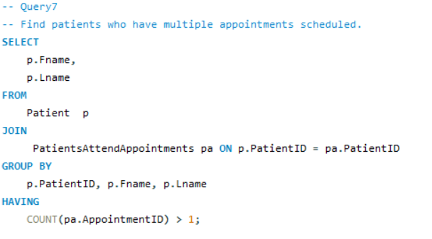
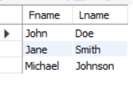

Slide 16
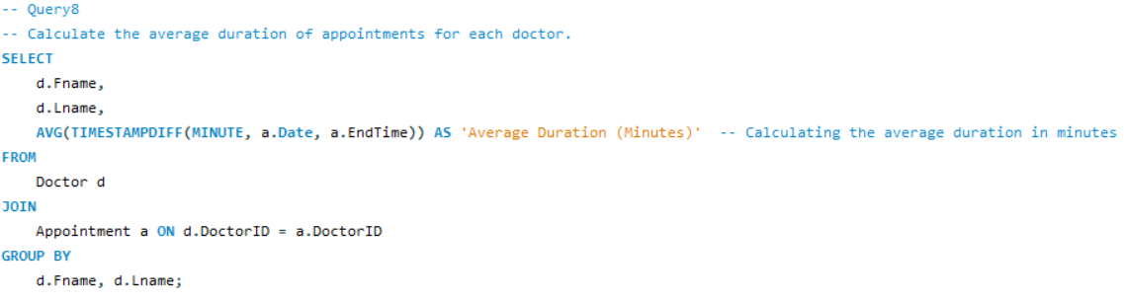
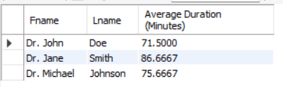

Slide 17
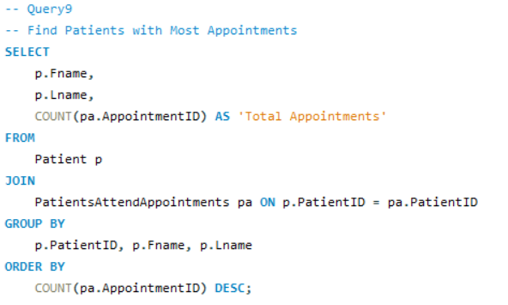
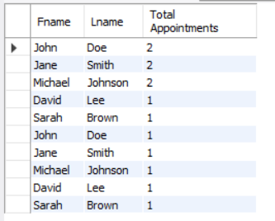

Slide 18
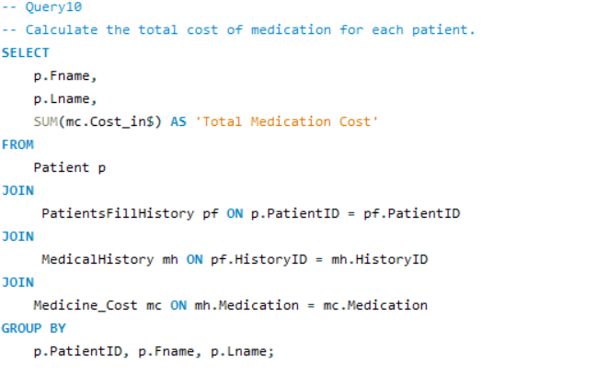
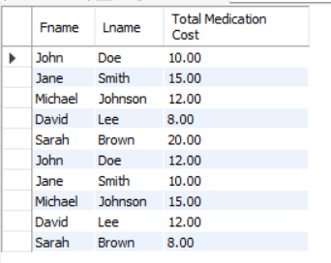

Slide 19
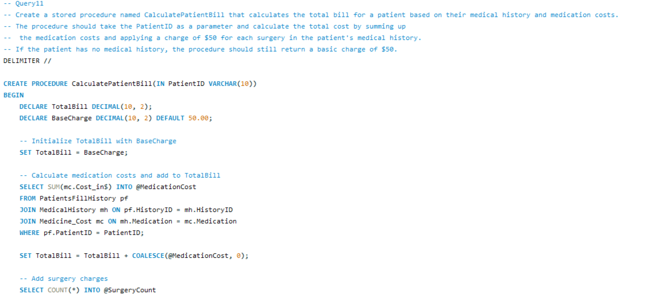
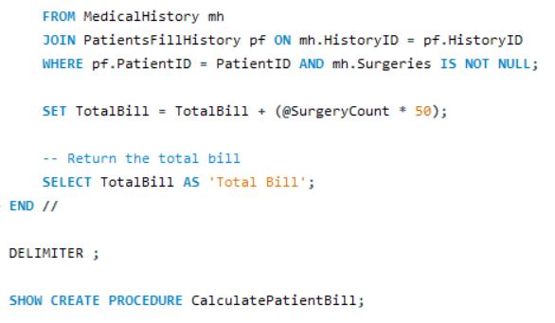

Slide 20
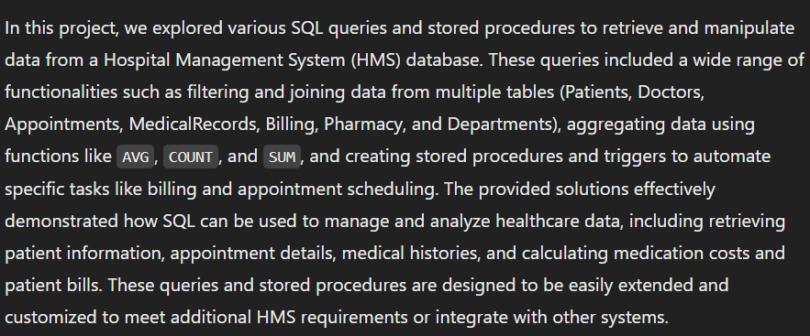
Summary:
Conclusion:

